Slide 1
Shared Class Notebook
Vincent Mac and Nicholas Chin
CSE 111-01, Professor Rusu

Slide 2
System Description
Database that allows students and their professors to add, update, and view each others notes within their respective classes.
Using a standard SQLite3 database and accessing with javascript (node.js module)

Slide 3
Implementation Details
Integrated Development Environment (IDE)
Microsoft Visual Studio Code
Database
SQLite3 Database
Language
SQLite3
HTML
CSS
Javascript (nodejs)

Slide 4
Important Use Cases
Students
Method of accessing note folders for your classes made by your professor
Ability to see folders of all of your registered classes
View and upload notes from your peers or professor
Professor
Add/Remove students ability to view their class
Ability to upload and edit class notes or documents for viewing
Act as the administrator for their class database

Slide 5
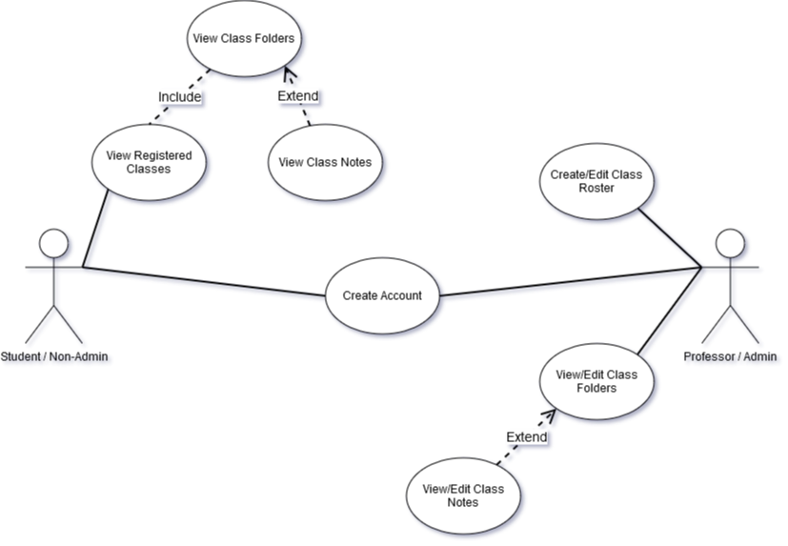
Use Case Diagram

Slide 6
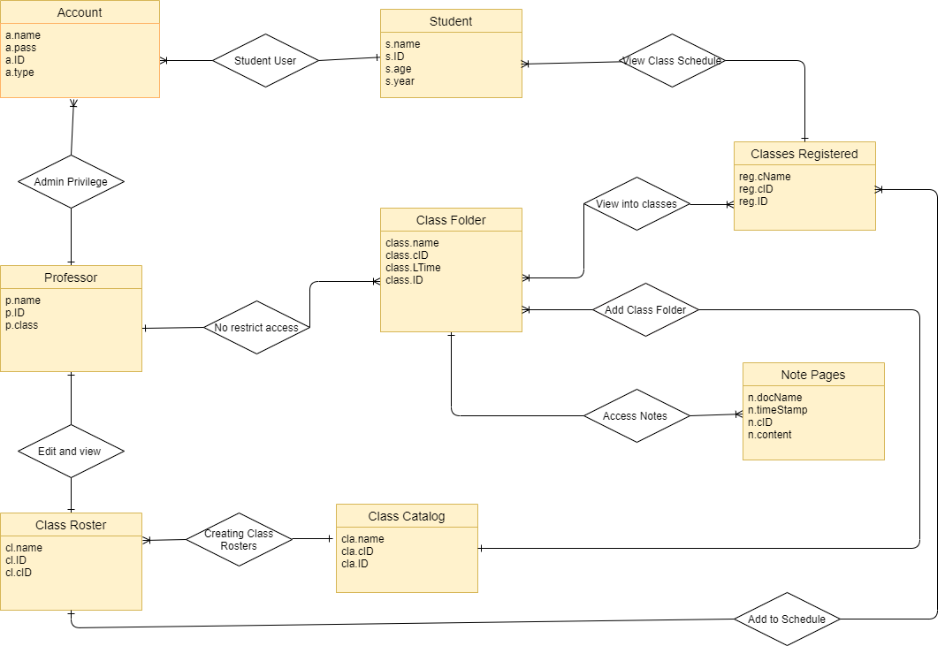
E/R Diagram

Slide 7
Relational Schema
ACCOUNT
a_name
a_pass
a_ID
a_type
STUDENT
s_name
s_ID
s_age
a_year
CLASSES REGISTERED
reg_cName
reg_cID
reg_ID
CLASS FOLDER
class_name
class_cID
class_LTime
class_ID
NOTE PAGES
n_docName
n_timeStamp
n_cID
n_content
PROFESSOR
p_name
p_ID
p_class
CLASS ROSTER
cl_name
cl_ID
cl_cID
CLASS CATALOG
cla_name
cla_cID
cla_ID

